Slide 1
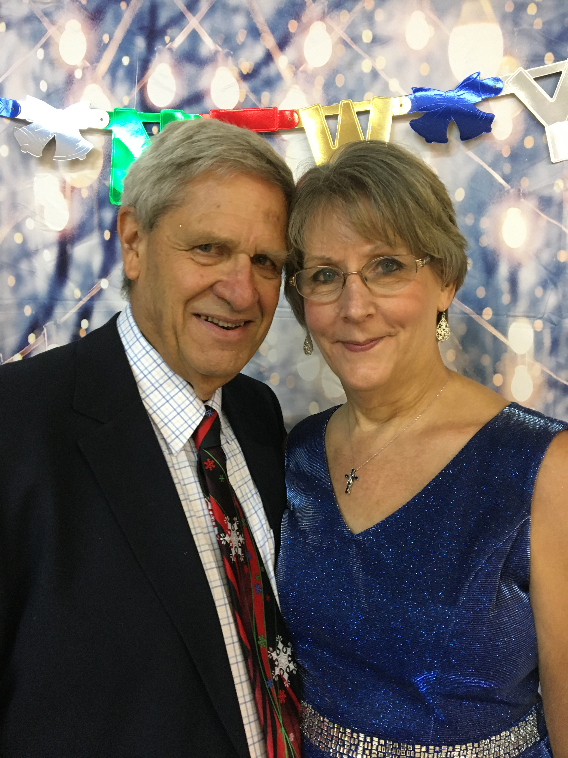
JANUARY JEWEL “A Gem of a Weekend for Fun-Loving ROUND DANCERS”
31st Annual
Phase II, III, IV
January 19-20, 2024
Shreveport, LA
Christ United Methodist Church, 1204 Crabapple Drive
FRIDAY
Check In On Arrival 6:30 PM
Advanced Rounds (IV-VI) 6:30-7:00PM
Program 7:00-9:30 PM
SATURDAY
Breakfast Breads 9:00-9:15
Warm Up Dances 9:15-9:30 AM
Workshop 9:30-11:30 AM
LUNCH 11:30-1:00 PM
Workshop 1:00-3:00 PM
Dinner & Relax 3:00-6:30 PM
Advanced Rounds (IV-VI) 6:30-7:00 PM
Program (II-IV) 7:00-9:30 PM
PER COUPLE Until Nov 30 – After Dec 1
Weekend $90 $100
Sat. W/S + Dance $60 $80
Sat. Night Dance Only $55 $60
Fri. Night Dance Only $55 $60
PRE-REGISTRATION
No refunds after January 1, 2024.
May be rolled over to 2025 only.
Sponsored by:
RED RIVER ROUNDERS
President Cindy Vantiger
vantigercynthia0321@gmail.com
Featured Instructors
FRED & LINDA AYRES
Longview, TX
*Mail to: Nancy Tatum, 4980 Old Oak Drive, Benton, LA 71006; 318-470-1692; nancytatummath@gmail.com Date paid_______________
Name (Last)______________________________His______________________ Hers______________________
Address___________________________________________________________ Dance Level II / III/ /IV / V_
(Circle appropriate number)
Phone__________________________________Email_______________________________________________
Cuer?__________ *For 2024 January Jewel, make check payable to RED RIVER ROUNDERS

